Slide 1
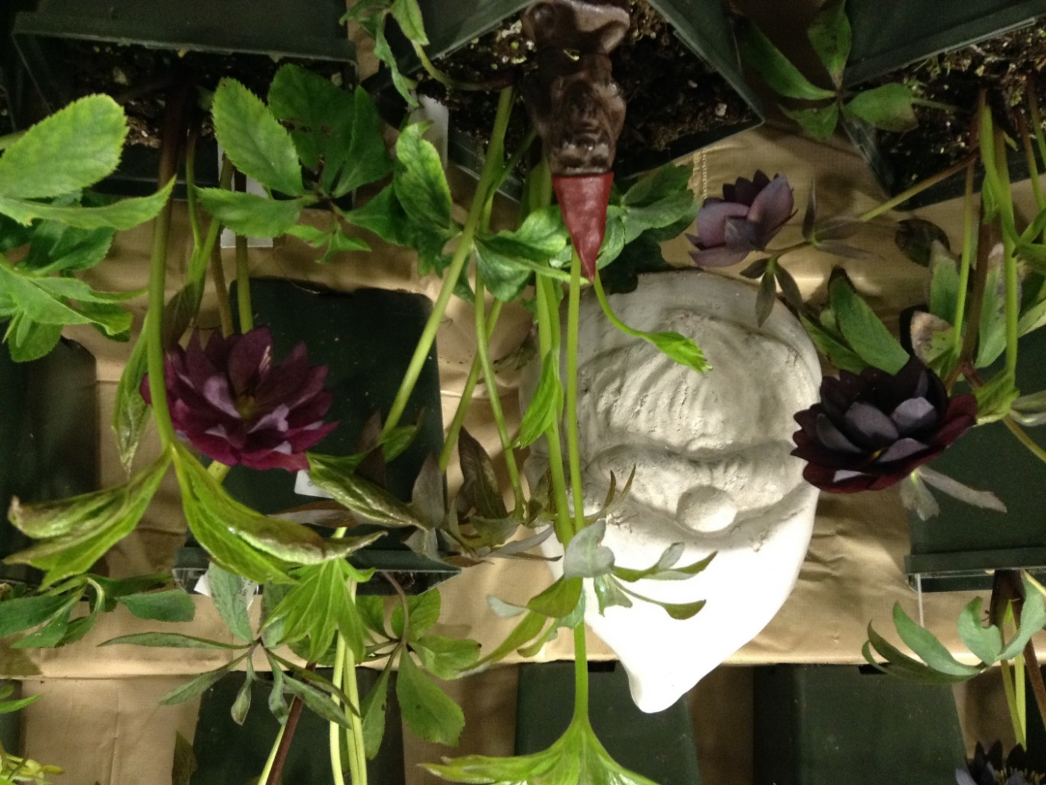
HELLEBORES

Slide 2
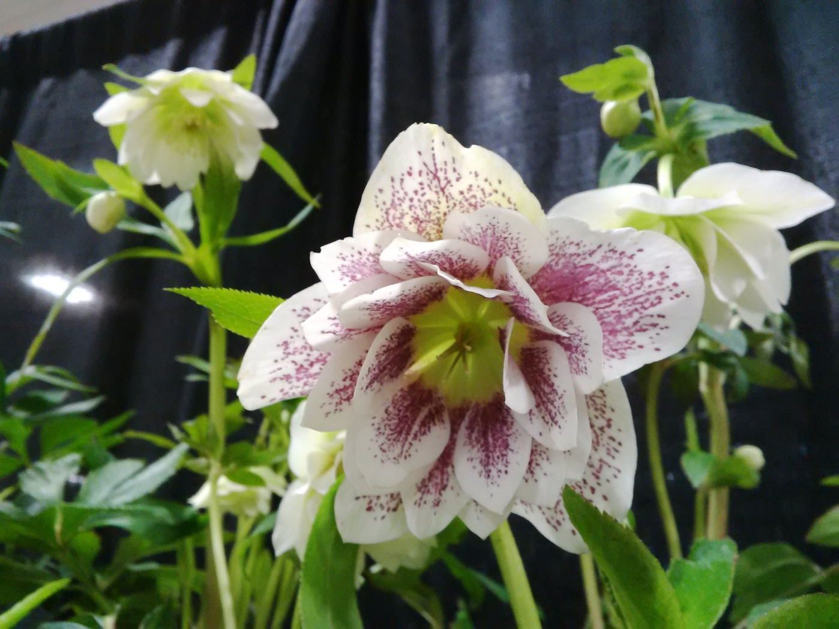
HEAVENLY HELLEBORES

Slide 3
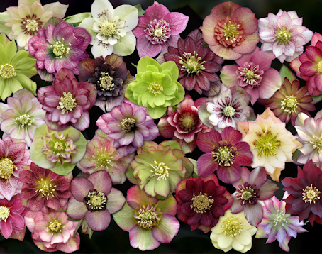
So why grow hellebores?
Hellebores are the true harbinger of spring. They can be grown in the garden, in containers and they can provide lovely, long lasting cut flowers in the house.

Slide 4
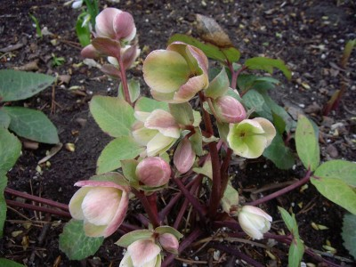
They are very hardy!
Whether you are living in a Vancouver, Edmonton, Toronto or have a garden as far south as Florida there’s a hellebore for you!

Slide 5
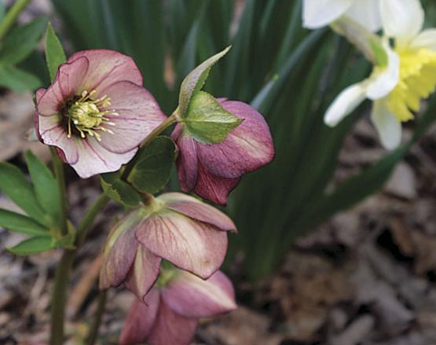
They bloom for a long time…
Flower bracts hold for up to three months on most varieties. Many of the flowers start out with intense colour and gradually fade through lovely colour variations.

Slide 6
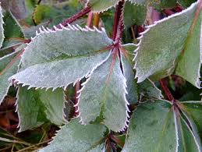
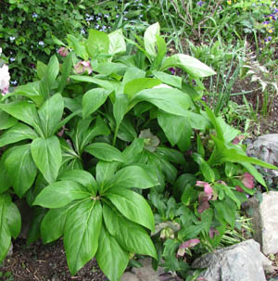
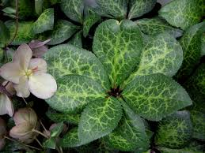
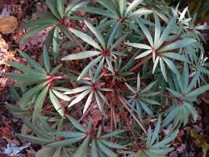
They have attractive foliage…
Most hellebores are considered evergreen. Their leaves add interest to hosta, ferns and other shade plants.

Slide 7
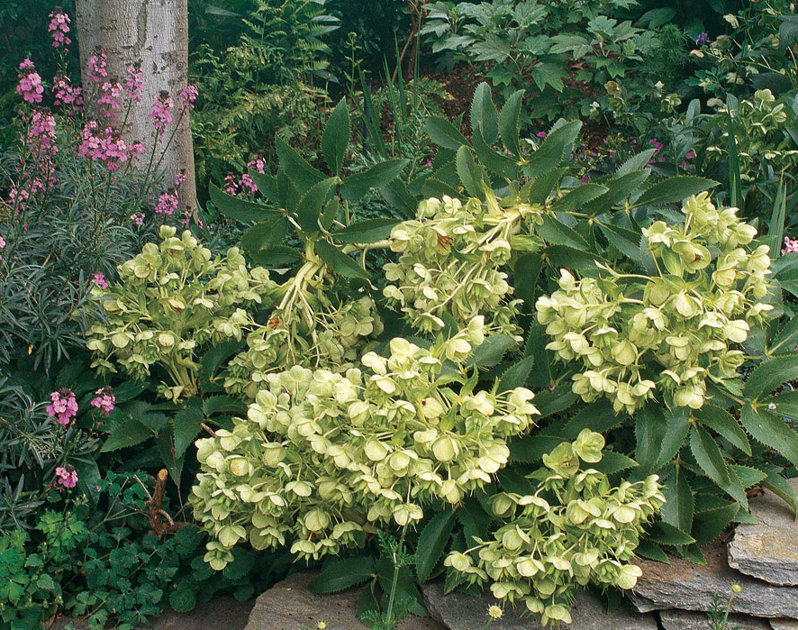
They thrive in a woodland setting…
Most hellebore are at their best growing in a shaded to semi shaded spot and like a lime soil.

Slide 8
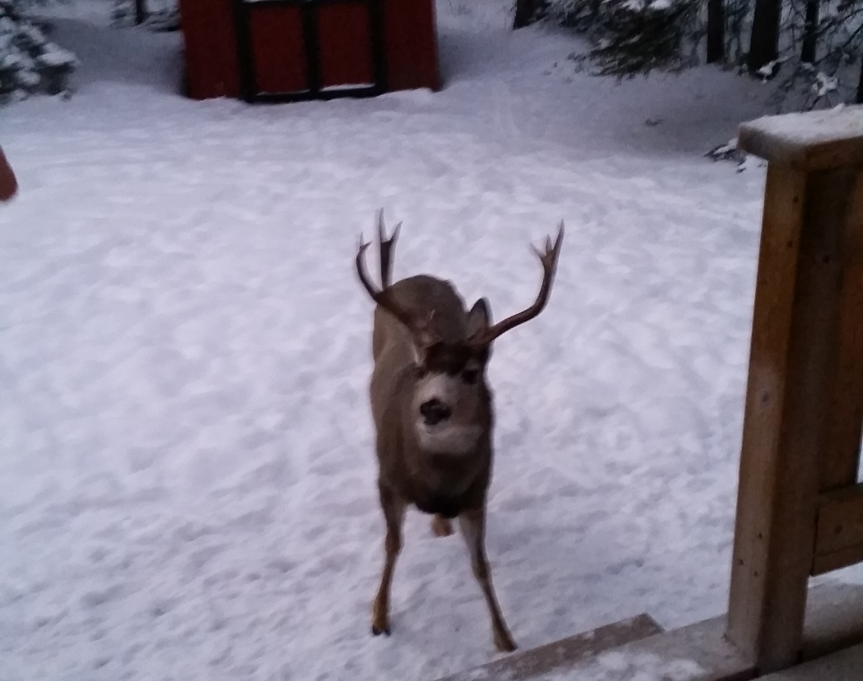
They’re deer proof…
And bunny proof and squirrel proof and chipmunk proof and…..need we say more!

Slide 9
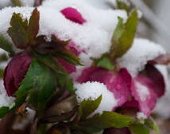
But mostly…….
…because they bloom when we need hope that spring will come and awaken our gardens again.

Slide 10
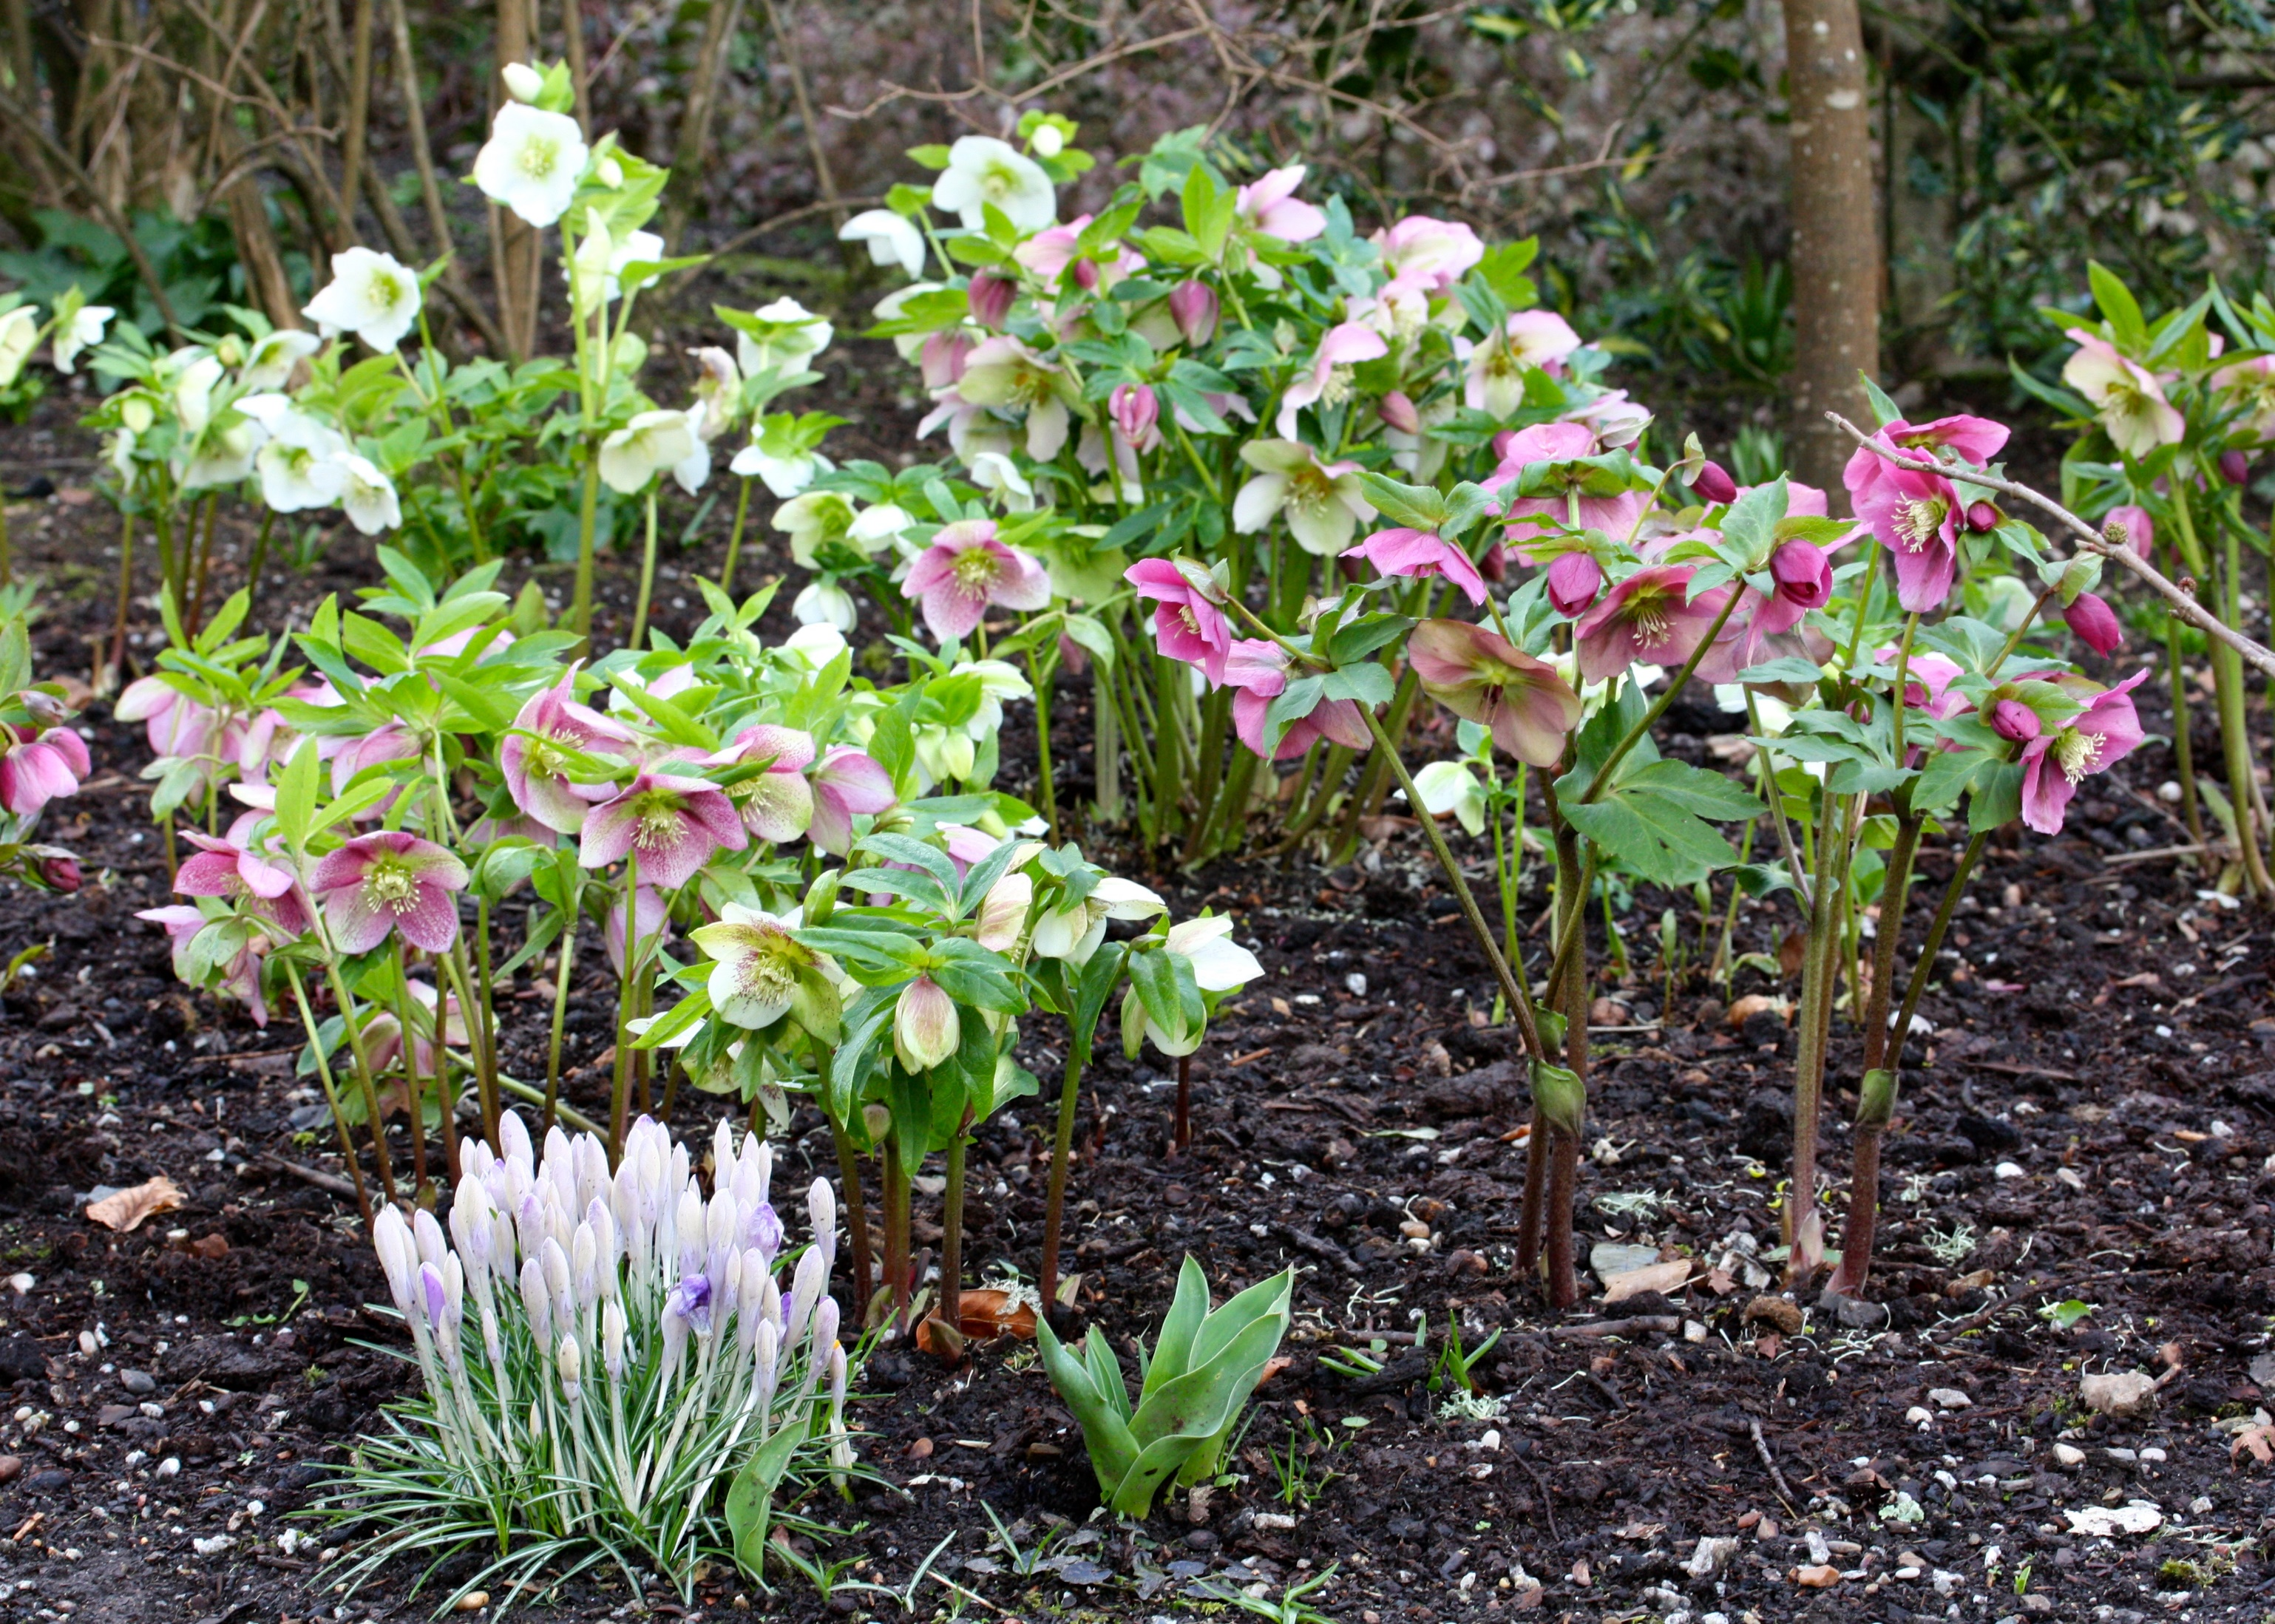

Slide 11
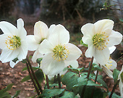
Christmas Rose
Hellebores niger
They bloom first - (Origin of the name comes from pre- Georgian calendar when orthodox Christmas was celebrated in January)
Dark dark evergreen matte green foliage
Foliage is “palmette” and not as toothed as orientalis.
Flowers are out-facing
Initially flowers open waxy white with large golden stamens. As the flower ages, the outside blush pink then green.

Slide 12
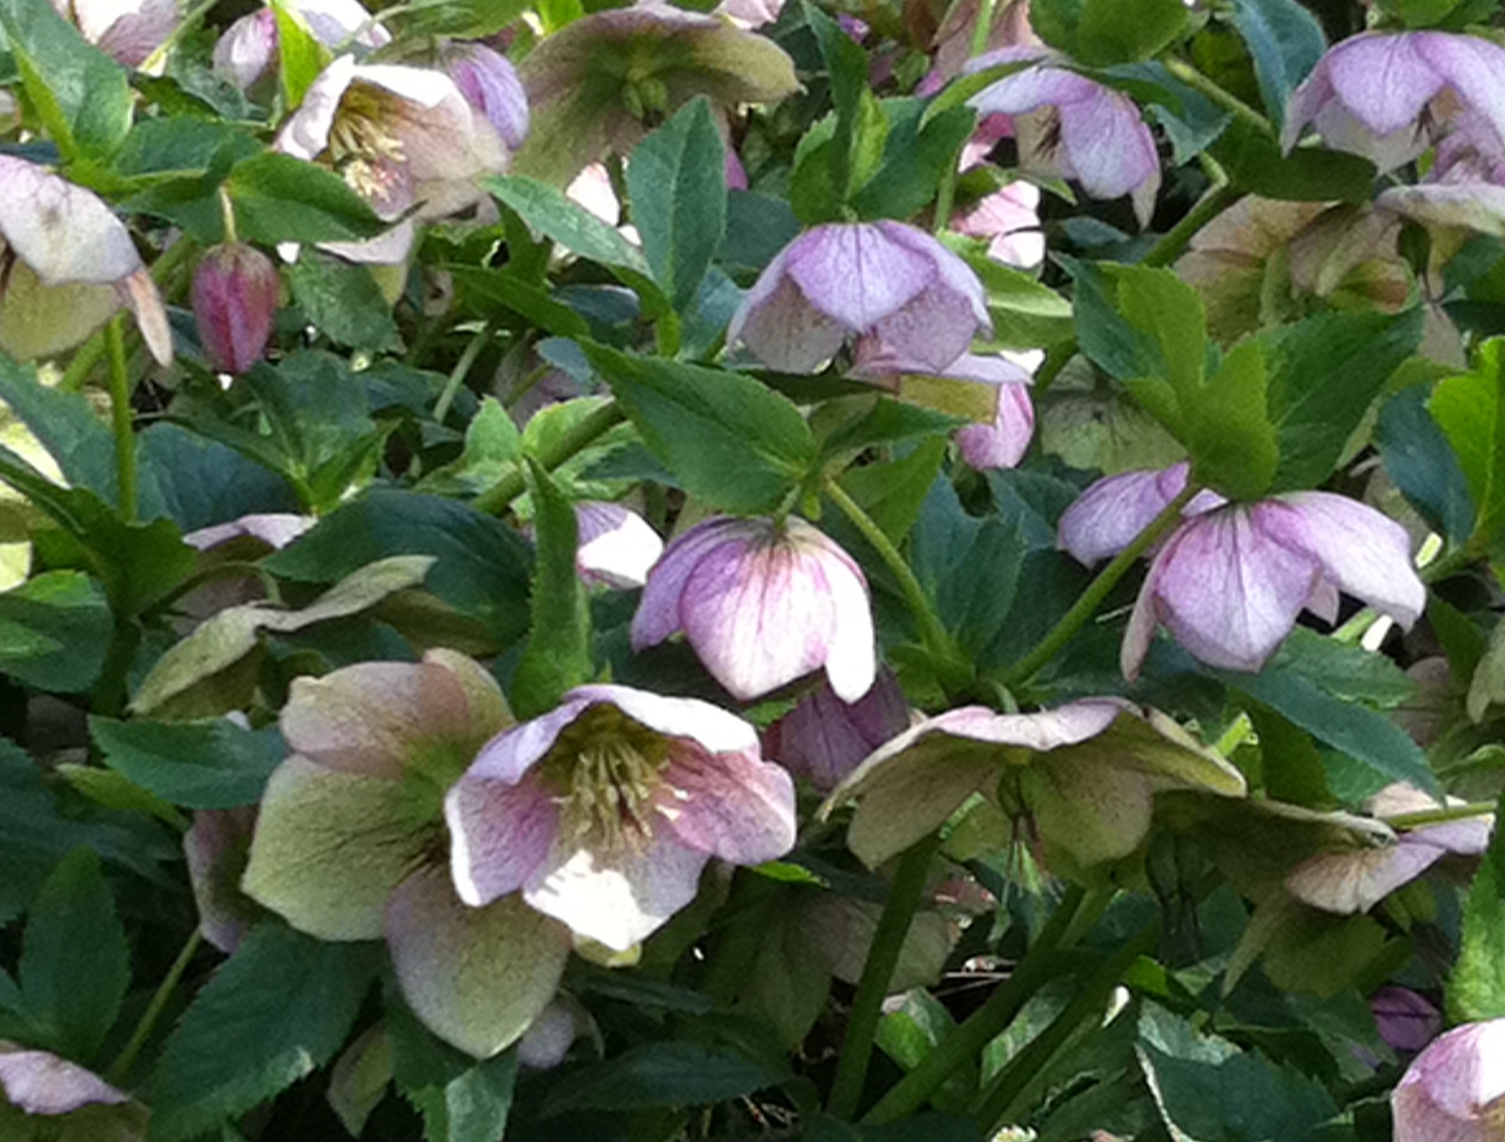
Lenten Rose
Hellebore orientalis
They bloom next – early spring!
Flowers come in a wide range of colours and are often spotted or freckled on the inside.
Nodding flowers are held high above the foliage. Many varieties are double.
Foliage is a glossy dark green, palmate and evergreen in mild winters.
Plants are much easier to grow than hel. niger and establish nicely sized clumps relatively quickly.

Slide 13
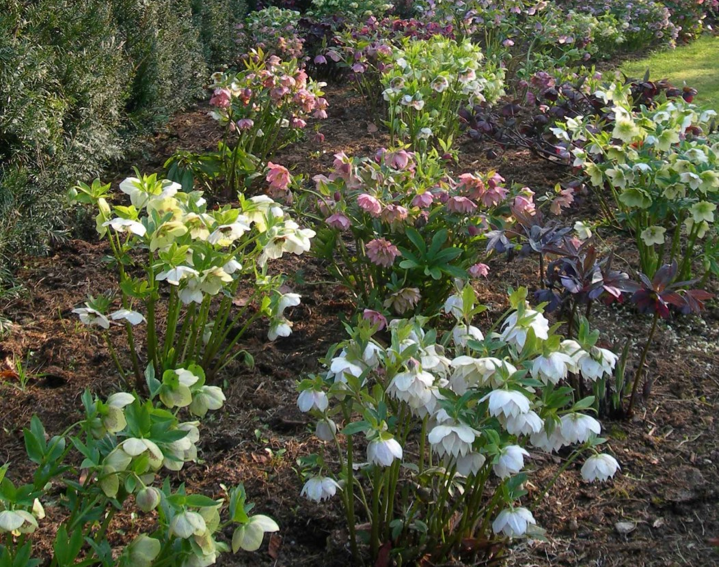
How to grow virtually all hellebores
They HATE being moved, so take the time to choose your site and prepare it well.
Woodland – deciduous is best (light in the spring, shade in the summer)
Lots of organic material.
Moisture to establish but then WELL DRAINED site.
Feed in the fall – they grow in the winter. Remember to check new plants for moisture until the ground freezes.
They don’t need splitting and since they typically are slow growing, why would you?

Slide 14
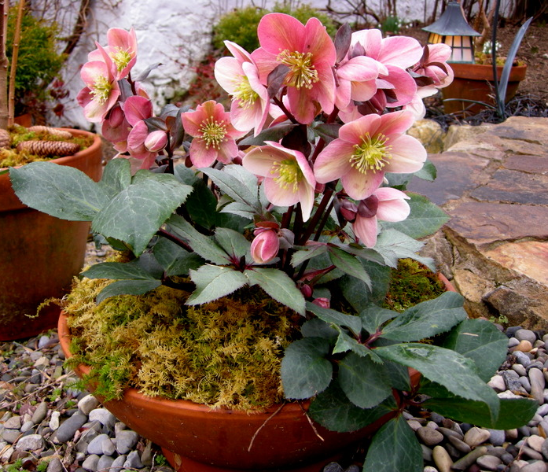
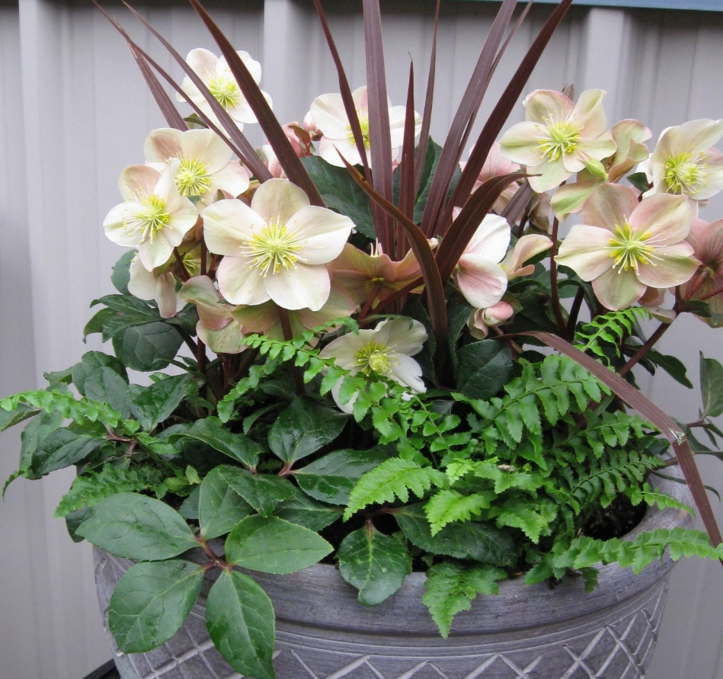
GROWING IN CONTAINERS
Choose your pot carefully – hellebore roots grow down rather than out, so they need a deep pot.
Need excellent drainage.
Heavy water needs in the spring and fall, but not so much in the summer.
Tend to become pot bound so plan to up pot them every couple of years.
Place your containers in a location where they’ll get dappled light.

Slide 15
